Slide 1
Capstone: Supervised Learning
Nick Chused
March 8, 2020

Slide 2
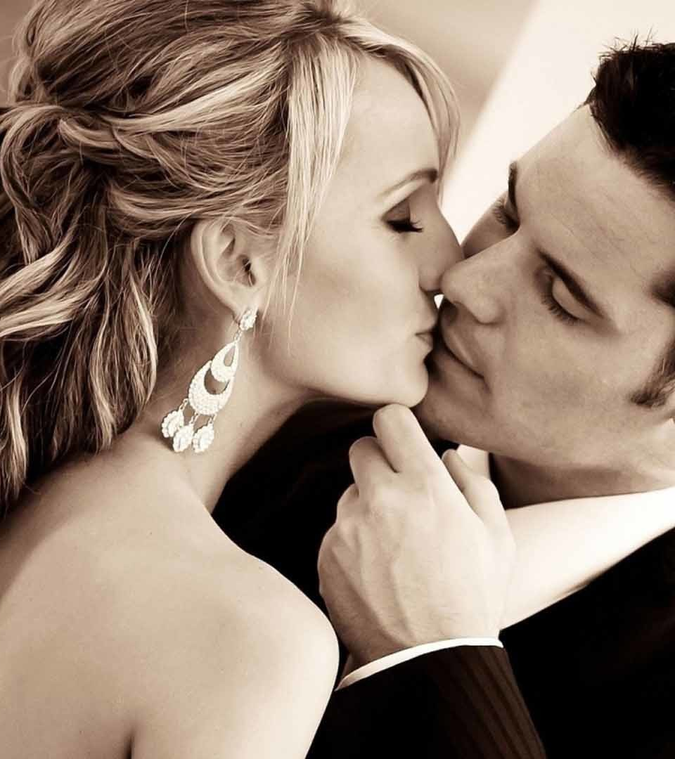
What makes you attractive?

Slide 3
About the data:
Data was gathered from 552 participants in experimental speed dating events from 2002-2004.
During the events, the attendees would have a four minute "first date" with every other participant of the opposite sex.
At the end of their four minutes, participants were asked if they would like to see their date again. They were also asked to rate their date on six attributes:
Attractiveness
Sincerity
Intelligence
Fun
Ambition
Shared Interests
The dataset also includes questionnaire data gathered from participants at different points in the process. These fields include:
Demographics
Dating habits
Self-perception across key attributes
Beliefs on what others find valuable in a mate
Lifestyle information

Slide 4
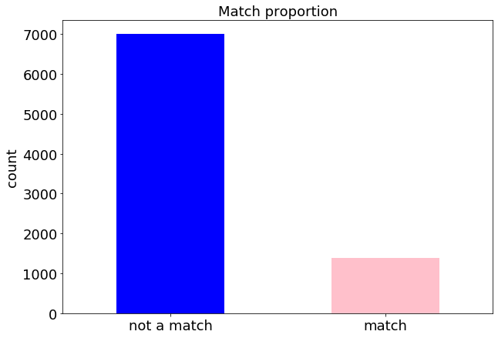

Slide 5
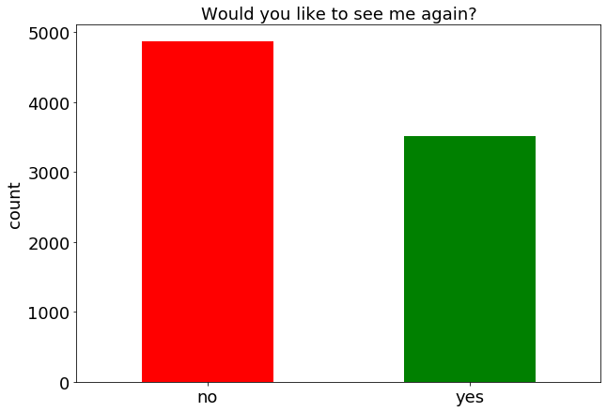

Slide 6
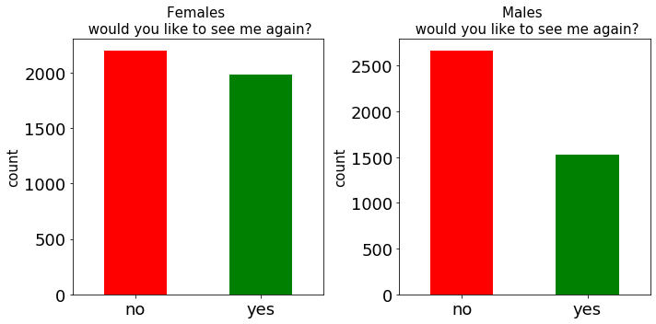

Slide 7
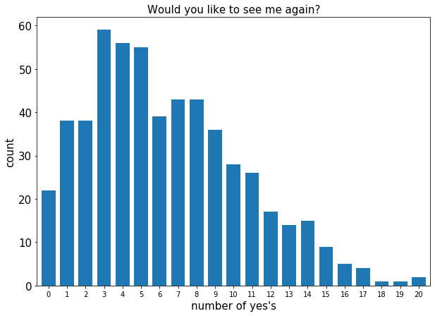

Slide 8
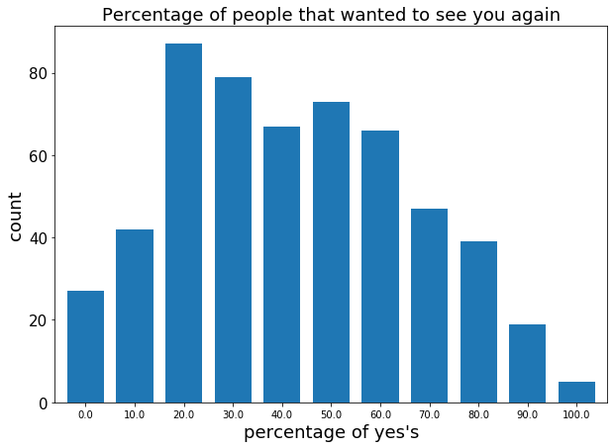

Slide 9
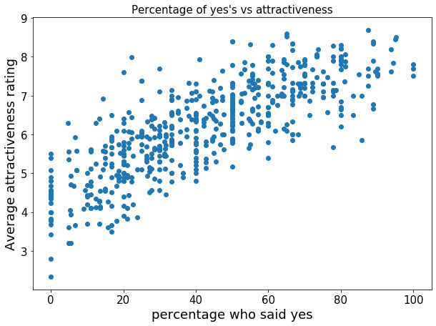

Slide 10
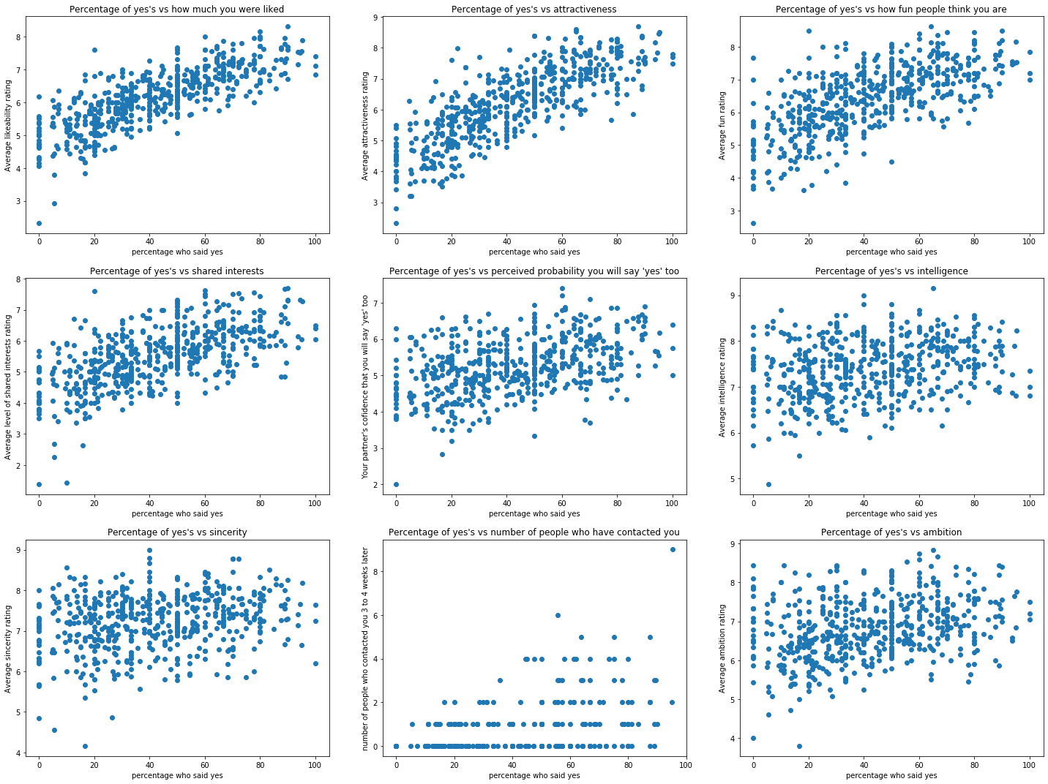

Slide 11
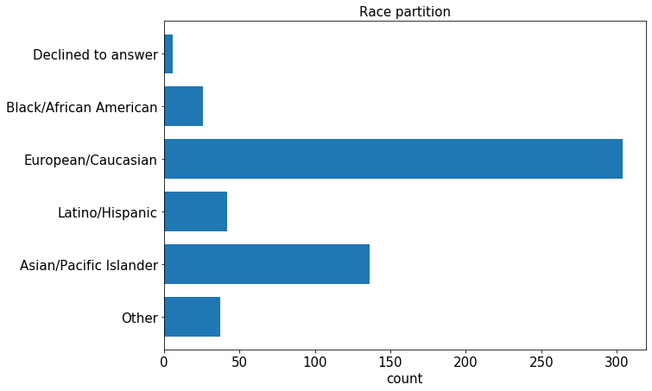

Slide 12
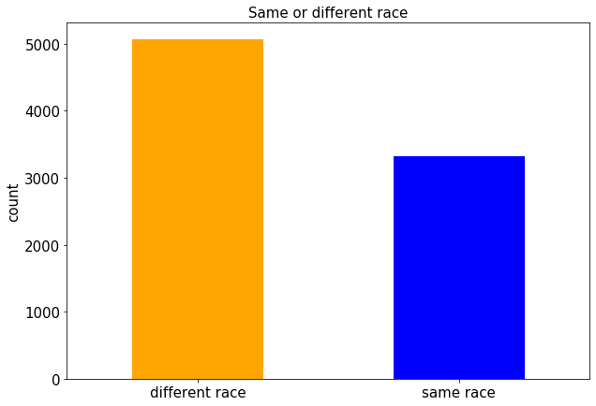

Slide 13
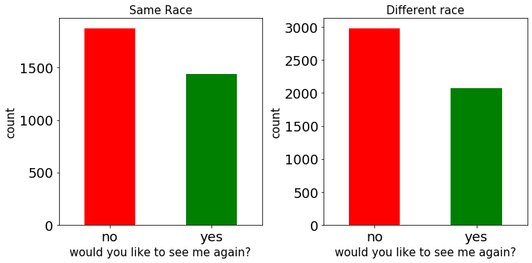
percentage of yes's for same race dates: 43.4%
percentage of yes's for different race dates: 41.01%

Slide 14
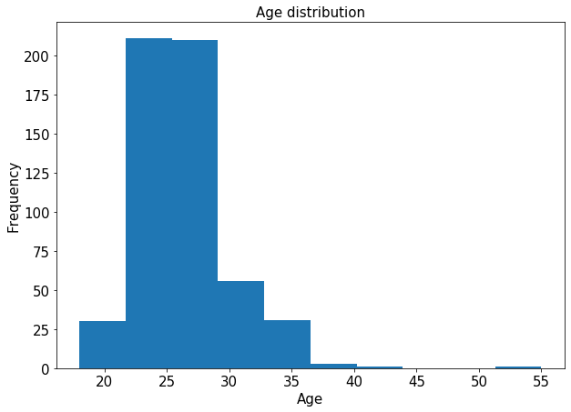

Slide 15
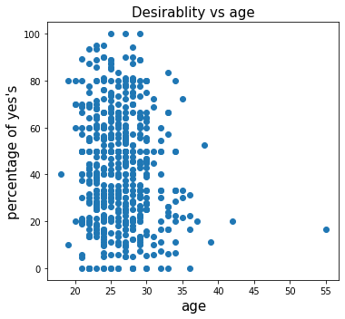

Slide 16
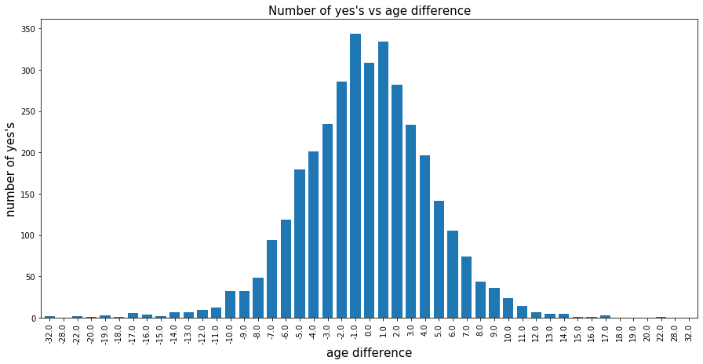

Slide 17
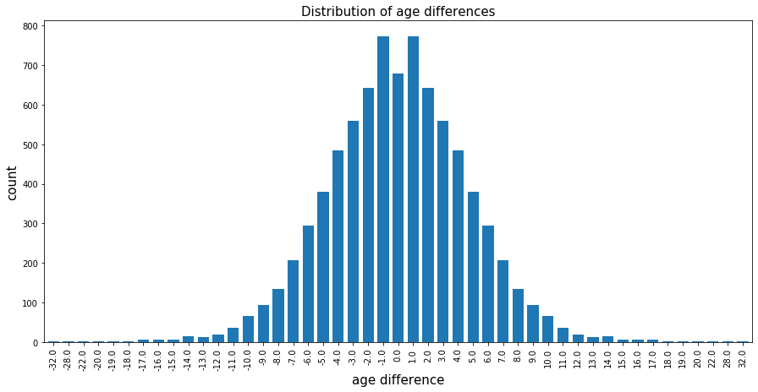

Slide 18
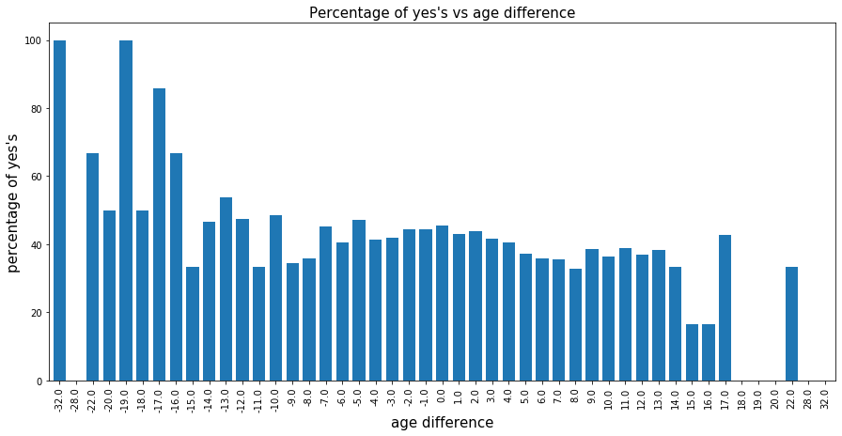

Slide 19
How accurately can a model predict if your date will want to see you again?

Slide 20
Accuracy of Logistic Regression: 0.788
Accuracy of SVM: 0.769
Accuracy of KNN (k = 10): 0.767
Accuracy of Random Forest: 0.765
Accuracy of Decision Tree: 0.700

Slide 21
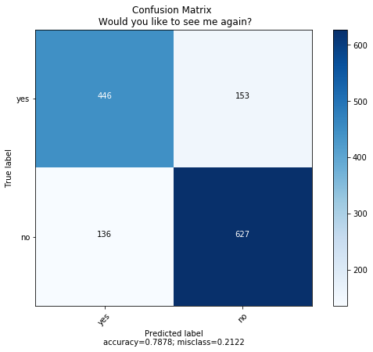
Confusion matrix, using linear regression

Slide 22
Predictive power of linear regression
Accuracy score: 0.79
Precision score: 0.77
Recall score: 0.74
Accuracy: The number of correct predictions over the total number of predictions
Precision: The proportion of positive predictions that were correct.
(When the model predicts that our date wants to see us again, they actually do 79% of the time)
Recall: The proportion of positives that were correctly predicted.
(When our date actually wants to see us again, the model picks it up 74% of the time)

Slide 23
How accurately can a model predict if you and your date will be a match?

Slide 24
Accuracy of KNN (k = 10): 0.864
Accuracy of Random Forest: 0.862
Accuracy of SVM: 0.849
Accuracy of Logistic Regression: 0.848
Accuracy of Decision Tree: 0.781

Slide 25
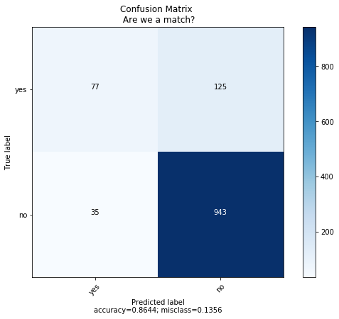
Confusion matrix, using KNN

Slide 26
Predictive power of KNN classifiers
Accuracy score: 0.86
Precision score: 0.69
Recall score: 0.38
Accuracy: The number of correct predictions over the total number of predictions
Precision: The proportion of positive predictions that were correct.
(When the model predicts that we are a match, we actually are 69% of the time)
Recall: The proportion of positives that were correctly predicted.
(When we actually are a match, the model picks it up 38% of the time)

Slide 27
How accurately can a model predict the percentage of dates that will want to see you again?

Slide 28
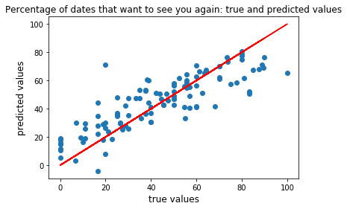
Mean absolute error of the prediction is: 10.49

Slide 29
Conclusion: If you want to find that special someone: be young, physically attractive, have a fun personality, and find someone with similar interests.

Slide 30
Practical use: Knowing what qualities make the greatest first impression
Shortcomings of the model:
No information on the qualities that make for a lasting relationship
More exploratory analysis could be done on distinguishing between the most desirable traits for males versus females
There are other factors to explore that could affect people’s attraction to each other in a speed dating event, such as the order in which people meet or how many people attended the event

Slide 31
Questions?

